Slide 1
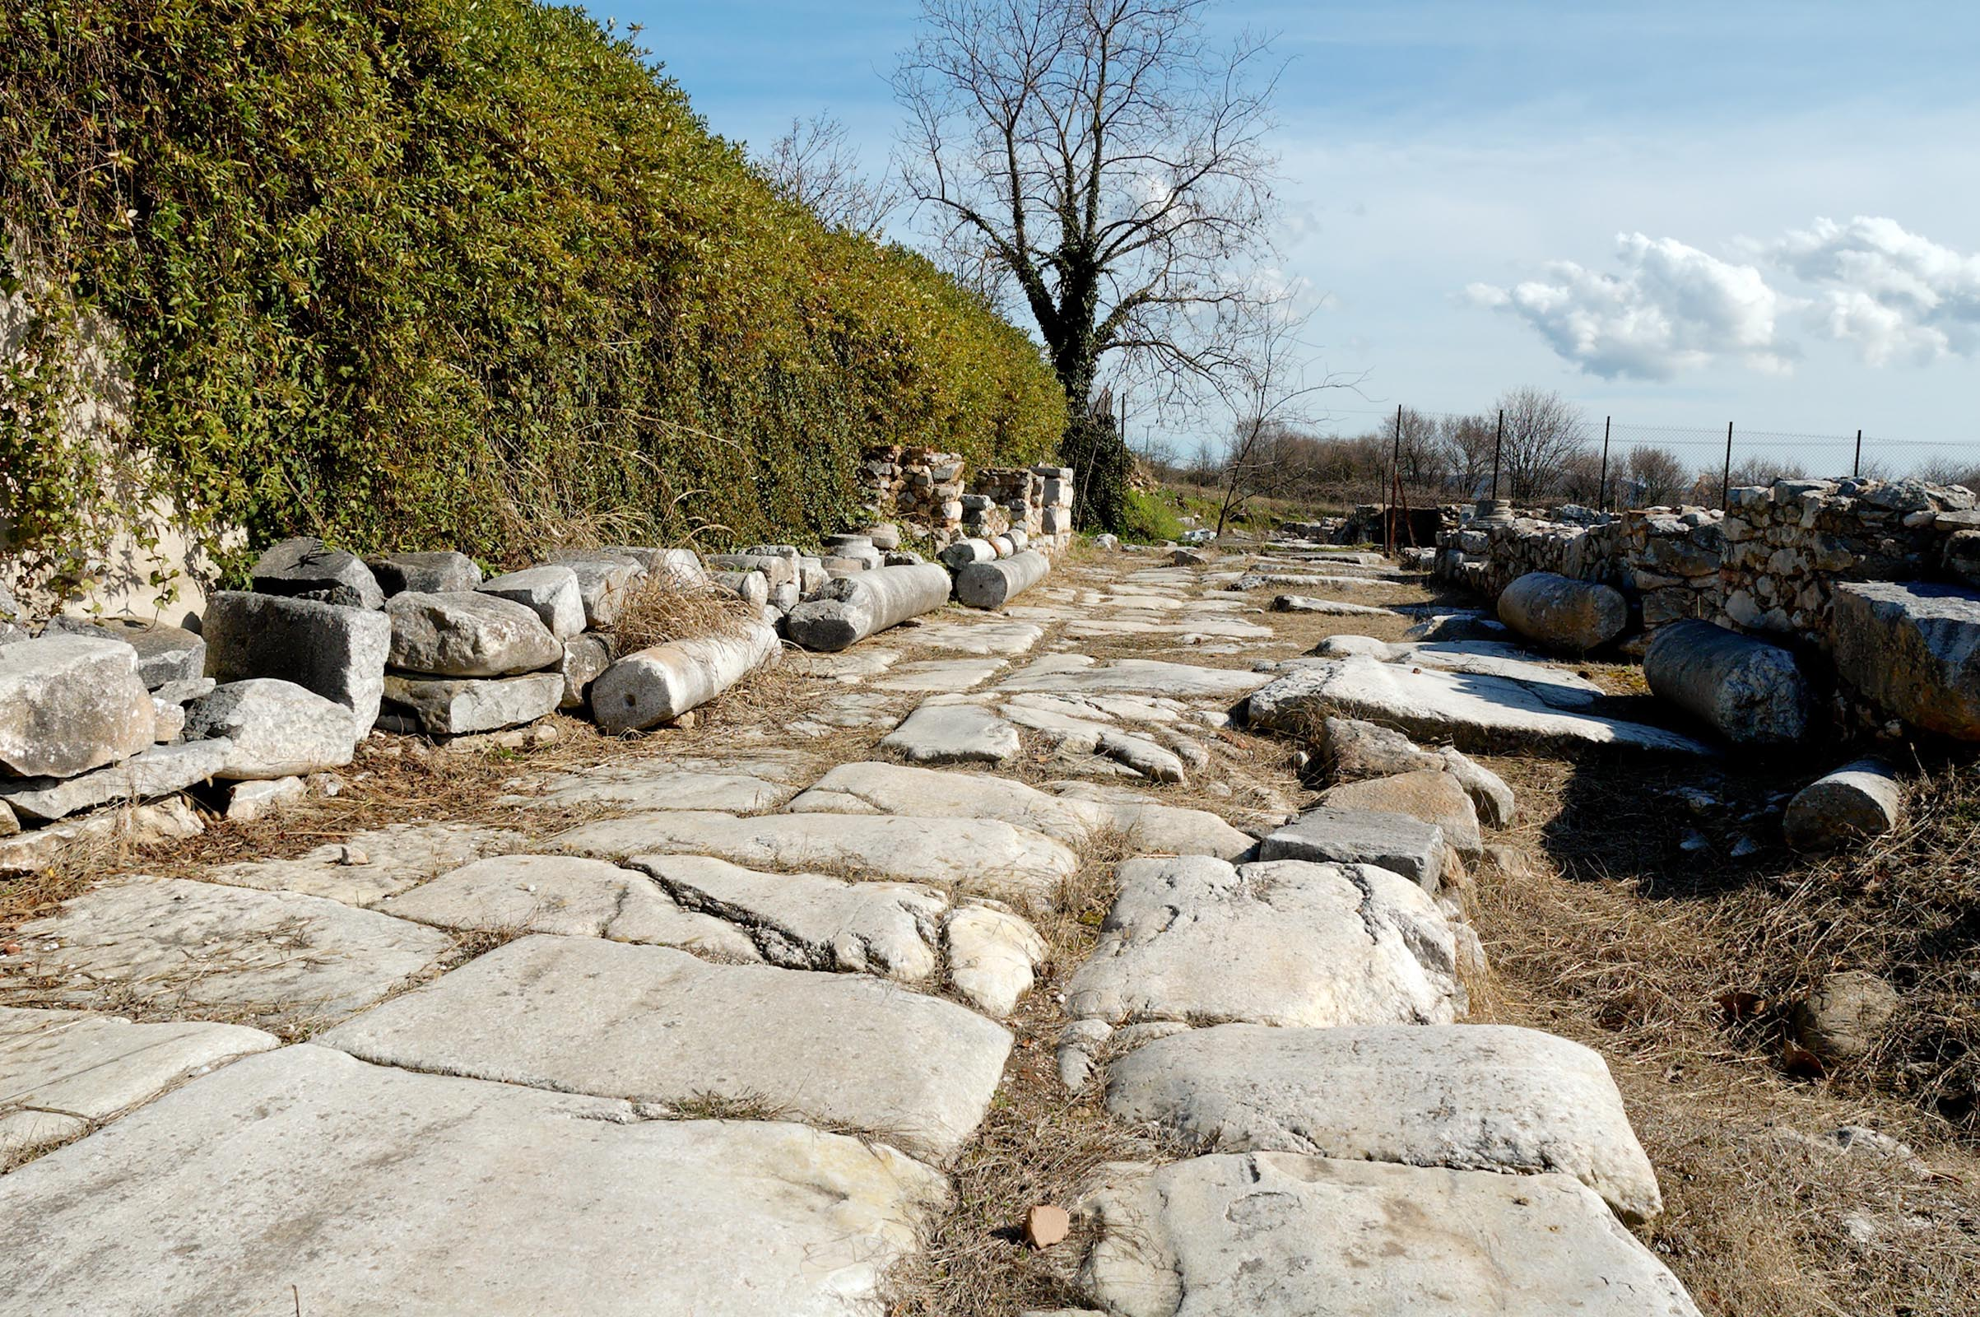
Philippians 2.1-4
Roman highway through ancient Philippi / ©2012 Todd Bolen / BiblePlaces.com

Slide 2
Philippians 2.1-4 NET: Therefore, if there is any encouragement in Christ, any comfort provided by love, any fellowship in the Spirit, any affection or mercy, complete my joy and be of the same mind, by having the same love, being united in spirit, and having one purpose. Instead of being motivated by selfish ambition or vanity, each of you should, in humility, be moved to treat one another as more important than yourself. Each of you should be concerned not only about your own interests, but about the interests of others as well.

Slide 3
Philippians 2.1-4 NET: Therefore, if there is any encouragement in Christ, any comfort provided by love, any fellowship in the Spirit, any affection or mercy, complete my joy and be of the same mind, by having the same love, being united in spirit, and having one purpose. Instead of being motivated by selfish ambition or vanity, each of you should, in humility, be moved to treat one another as more important than yourself. Each of you should be concerned not only about your own interests, but about the interests of others as well.

Slide 4
Philippians 2.1-4 NET: Therefore, if there is any encouragement in Christ, any comfort provided by love, any fellowship in the Spirit, any affection or mercy, complete my joy and be of the same mind, by having the same love, being united in spirit, and having one purpose. Instead of being motivated by selfish ambition or vanity, each of you should, in humility, be moved to treat one another as more important than yourself. Each of you should be concerned not only about your own interests, but about the interests of others as well.

Slide 5
Philippians 2.1-4 NET: Therefore, if there is any encouragement in Christ, any comfort provided by love, any fellowship in the Spirit, any affection or mercy, complete my joy and be of the same mind, by having the same love, being united in spirit, and having one purpose. Instead of being motivated by selfish ambition or vanity, each of you should, in humility, be moved to treat one another as more important than yourself. Each of you should be concerned not only about your own interests, but about the interests of others as well.

Slide 6
Philippians 2.1-4 NET: Therefore, if there is any encouragement in Christ, any comfort provided by love, any fellowship in the Spirit, any affection or mercy, complete my joy and be of the same mind, by having the same love, being united in spirit, and having one purpose. Instead of being motivated by selfish ambition or vanity, each of you should, in humility, be moved to treat one another as more important than yourself. Each of you should be concerned not only about your own interests, but about the interests of others as well.

Slide 7
Philippians 2.1-4 NET: Therefore, if there is any encouragement in Christ, any comfort provided by love, any fellowship in the Spirit, any affection or mercy, complete my joy and be of the same mind, by having the same love, being united in spirit, and having one purpose. Instead of being motivated by selfish ambition or vanity, each of you should, in humility, be moved to treat one another as more important than yourself. Each of you should be concerned not only about your own interests, but about the interests of others as well.

Slide 8
Philippians 2.1-4 NET: Therefore, if there is any encouragement in Christ, any comfort provided by love, any fellowship in the Spirit, any affection or mercy, complete my joy and be of the same mind, by having the same love, being united in spirit, and having one purpose. Instead of being motivated by selfish ambition or vanity, each of you should, in humility, be moved to treat one another as more important than yourself. Each of you should be concerned not only about your own interests, but about the interests of others as well.

Slide 9
Philippians 2.1-4 NET: Therefore, if there is any encouragement in Christ, any comfort provided by love, any fellowship in the Spirit, any affection or mercy, complete my joy and be of the same mind, by having the same love, being united in spirit, and having one purpose. Instead of being motivated by selfish ambition or vanity, each of you should, in humility, be moved to treat one another as more important than yourself. Each of you should be concerned not only about your own interests, but about the interests of others as well.

Slide 10
Philippians 2.1-4 NET: Therefore, if there is any encouragement in Christ, any comfort provided by love, any fellowship in the Spirit, any affection or mercy, complete my joy and be of the same mind, by having the same love, being united in spirit, and having one purpose. Instead of being motivated by selfish ambition or vanity, each of you should, in humility, be moved to treat one another as more important than yourself. Each of you should be concerned not only about your own interests, but about the interests of others as well.

Slide 11
Philippians 2.3-4 NET: Instead of being motivated by selfish ambition or vanity, each of you should, in humility, be moved to treat one another as more important than yourself. Each of you should be concerned not only about your own interests, but about the interests of others as well.

Slide 12
Philippians 2.3-4 NET:
Instead of being motivated by selfish ambition or vanity, each of you should, in humility, be moved to treat one another as more important than yourself. Each of you should be concerned not only about your own interests, but about the interests of others as well.
κενοδοξία = vanity, conceit, delusion
κενός [empty] + δόξα [glory]

Slide 13
Philippians 2.3-4 NET: Instead of being motivated by selfish ambition or vanity, each of you should, in humility, be moved to treat one another as more important than yourself. Each of you should be concerned not only about your own interests, but about the interests of others as well.

Slide 14
Philippians 2.3-4 NET: Instead of being motivated by selfish ambition or vanity, each of you should, in humility, be moved to treat one another as more important than yourself. Each of you should be concerned not only about your own interests, but about the interests of others as well.

Slide 15
Philippians 2.3-4 NET: Instead of being motivated by selfish ambition or vanity, each of you should, in humility, be moved to treat one another as more important than yourself. Each of you should be concerned not only about your own interests, but about the interests of others as well.
Proverbs 11.2 NET: When pride comes, then comes disgrace, but with humility comes wisdom.

Slide 16
Philippians 2.3-4 NET: Instead of being motivated by selfish ambition or vanity, each of you should, in humility, be moved to treat one another as more important than yourself. Each of you should be concerned not only about your own interests, but about the interests of others as well.

Slide 17
Philippians 1.27-2.4
Roman highway through ancient Philippi / ©2012 Todd Bolen / BiblePlaces.com

